Slide 1
G5 AMPAP - Airport Economics and Commercial Management
John Italume
Claudio Madariaga
Funmilayo Olonisakin
Emily Phillipe
Geneva M. Turner
June 29, 2023

Slide 2
Problem Statement
Commercial aspects of civil aviation face many economic challenges, one of which is the financial relationship between airlines and airports related to delivery of current services and preparation for future capacity and service level enhancements.

Slide 3



Current user-charge positions of leading civil aviation organizations
International Civil Aviation Organization
Recommends States charge only for services and function which are provided for, directly related to, or ultimately beneficial for, civil aviation operations
Includes airport charges, landing, hangar, parking, passenger, security, fuel, and rental fees
Four principles to be incorporated for rate setting: Non-discrimination, Cost Relatedness, Transparency and Consultation.
Airport Council International (ACI)
Principal that users should bare costs of facilities to finance investments in infrastructure.
International Air Transport Association (IATA)
Advocates for cost-related charges. User should only cover the costs of providing services to airline and passengers.
Organizations agree to support transparency and consultation with stakeholders in setting user charges. There is consensus that rates must be balanced between the needs of all.

Slide 4
Forces of change that will impact future relations between airlines & airports
To address this point, we have identified what is occurring or might occur that may affect the relations.
 | Description | Impact over | + Consequences | Consequences
Innovation | Generation of new products and new services due to innovation like digitalization, IoT, AI, new type of Fuel, between others can force a change in the industry. | Number of resources required (personnel, materials, etc.) Effort required to absorb and answer to the changes. | Aviation reputation Costs reduction New personnel skills Increase of the customer satisfaction | If the message is not properly managed, this can affect Airlines and Airport reputation in terms of impact over employees and public opinion.
Economy | Airlines and Airports are operating under a lot of pressure, in terms of costs, and with a very low capacity to manage and/or influence the results like: Inflation, GDP, stability of big countries can affect, fuel, personnel costs. | Airport and Airlines models to operate Sources of revenue | Aviation is pushed to look for alternatives. If the engagement of global entities, governments and regulators is committed the changes can be less impactful for the whole industry. | Some actors can decide to sacrifice key aspects of the operations like safety, security, efficiencies quality of services and customer satisfaction, environmental care
Demand | The volume of passenger neither the volume of the cargo can be totally predicted. In addition to that, the profile of the passengers is changing then their needs. The type of aircrafts is changing as well so the needs of space and services will vary. | Required infrastructure and services Personnel skills and number of people Aeronautical and not aeronautical revenue | Innovative solutions must be implemented to optimize the infrastructure avoiding extra investments and allowing the incremental or decremental of passengers. | The main issue is that when there is not the typical demand, the Airports and Airlines don’t have the capacity to adapt or reduce resources with the same speed and volume.

Slide 5
Forces of change that will impact future relations between airlines & airports (cont.)
 | Description | Impact over | + Consequences | Consequences
Competition | Looking for new sources of the revenue, the industry will increase the level of the competition. | Competition between Airlines and Airports, Airlines vs Airlines, Airports vs Airports, etc. | Creation of new services, Creation of new routes, New business models | The short companies are under high risk to disappear, and this can create monopolies and in consequence a rebound effect.
Regulation | If Governments and global entities promotes changes about sources or rules of the revenue. | How the industry operates in terms of Till models Mandatory investments Revenue sources | The changes can be accelerated. If the aviation’s ecosystem is integrated, the result can be permanent and beneficial for every stakeholder. | Acceleration doesn’t mean that is good for everybody, if the aviation’s ecosystem is not integrated to generate a substantial change there are high possibilities of failure.

Slide 6
Potential future changes in public policy can support industry development.
Top potential future changes includes the Airport and Airlines partnering together to:
Optimize technology to assist with future demand
Facilitation to ensure there is capacity for continued growth which may include identifying additional or flexible funding
Increase NAR (Non Aeronautical Revenue) by improving customer experience and accessibility
Ensure business continuity
Reduce the impact of negative externalities
Technology includes the following
Encourage and develop civil aeronautics
Developing touchless customer experience
Biometric screening utilizing facial recognition
Automated check-in and/or electronic boarding information
Digitizing bag – tracking
Facilitation includes the following
Constant consideration of the flow of customers throughout the airport and to/from aircraft
Maintaining clean facilities
Providing accessibility options customers
Review funding options to improve and expand airport through investments and bonds for anticipated growth

Slide 7
Potential future changes in public policy can support industry development (cont.)
Increasing NAR includes the following
Continuation of customer satisfaction
Customers tend to spend more when they are less frustrated and have more time to shop/eat
Develop more ways to track and learn from customer behaviors to anticipate there wants and needs
Develop flexible ways for payment
Business Continuity includes the following
Regulating civil aviation to promote safety
Safety will continue to be a priority for customers as they fly
Airport must have back up generators, back up plans to divert customers should there be an emergency
Airports and Airlines must continue to prepare for various emergencies and continue to lean an improve plan
Reduce the impact of negative externalities
Increase sustainability efforts
Promote competition

Slide 8
Changes in other course session topic areas can either further challenge and/or create new opportunities to address user charge relations
Airport user charges are source of revenue to an airport, however, review or changes in these user charges indirectly impacts on the activities of the Airlines that operate in the Airport.
The Airline business is centered on the operation and management of the air transport business which is being influenced by the demand and supply factors which controls the Air transport market. Changes in cost of operations of the airlines due to increase in Aviation fuel and other maintenance cost may lead to high cost of air ticket thereby reducing the number of Air travelers. Review of government regulatory policies on the Aviation sector may make Airlines to consider merger and acquisition thereby ensuring a stronger Airline business.
The Airport management may decide to implement some commercial strategy which may impact directly on the activities of the Airlines however, commercial strategy is intended to offset aeronautical revenue shortfalls, support airline activity and boost customer experience therefore, a review of rates by the Airport management may influence the decision of the Airline operators. Commercial service decision making must respond to evolving customer patterns security, convenience and brand recognition.

Slide 9
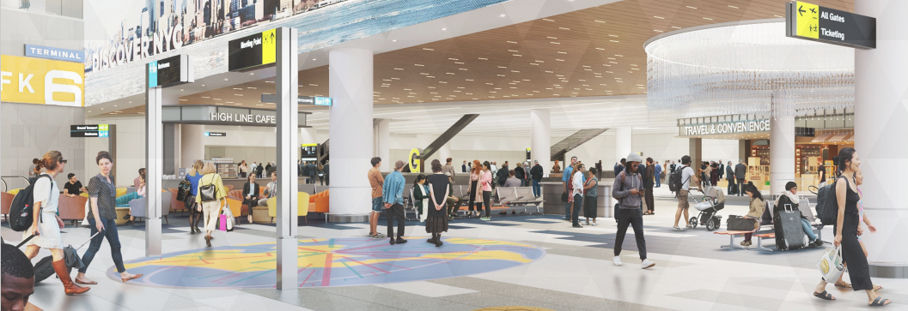
Changes in other course session topic areas can either further challenge and/or create new opportunities to address user charge relations (cont.)
A change in contract terms and processes sometimes strengthens the operations of the Airport. This also have the capacity to affect the revenue of the Airport therefore, an automated process of contracts may ensure seamless process of revenue generation as well as enhancing the retail operations in the Airport. Automated contract process will help to eliminate fraud and enhance the data collection system of the Airport.
Implementation of advance technology in the flow process will reduce the waiting time of customers and other Airport users as this will also eliminate multiple charges for customers. Enhancing customer experience at the Airports is very essential as this will definitely increase passenger traffic and create confidence to the Airport users.
Image Courtesy of the Port Authority of NY & NJ

Slide 10
Changes in other course session topic areas can either further challenge and/or create new opportunities to address user charge relations (cont.)
COURSE SESSIONS | DETAILS | CHANGES | NEW OPPORTUNITIES
Airline business | This involves revenue and cost of operations of the Airlines. | A review of the rates on aeronautical revenue alongside government regulations may impact on the operations of the Airlines. | This may stimulate new business ideas by the airlines as well as merger of somes airlines to enhance their services.
Airport Economics | This addresses the financing, demand analyses, ownership models and socio-economic impact of the Airport on Air transport business. | Policy changes may affect the efficiency of the Airport. This may be a change in the ownership structure of the Airport. | This may lead to improved benchmarking and goal setting for the Airport which enhances the efficiency in the operations of the Airport.
Airport Commercial development | This involves strategies and programs that enhances the development of the Airport. It mostly aids the total hauling of the Airport system. | A review of the rates and retail business in the Airport can futher impact on the non-aeronautical charges of the Airport. | This can stimulate effective partnership with various stakeholders so as to improve service delivery. It may also bring about land development for future contract negotiations.
Customer experience management | This includes a sum total of the interactions of the passengers at the Airport. This must align with the needs and expectations of the customers. | The critical components of the passenger experience is safety; a change in this and other social interactions may have an impact on the Customer experience. | This can bring about development through effective employee engagement thereby sustaining positive programs.
Airport Facilitation | This involves the management of complex processes and the flows of business operations in the Airport. | A review of the flows in operations may stimulate changes in user charges which may reflect improvement in revenue or processes. | Changes in Airport facilitation may lead to sustainability of technological advancement due to modern realities.

Slide 11
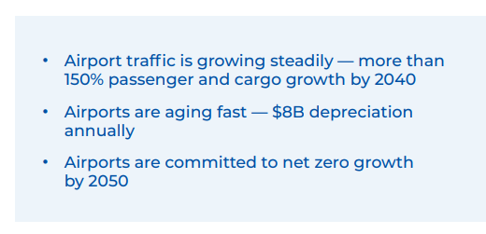
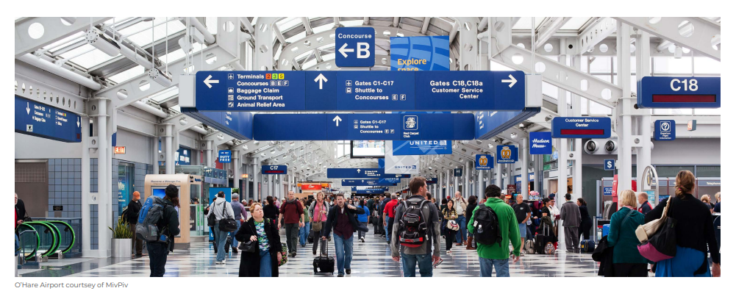
Conclusions
After observing the current user-charge positions, challenges, and the forces of change that may apply pressure over the Airports and Airlines relationship may consider the revenue potentials in the future will not be same as we operate today.
Airports, Airlines, and Stakeholders will face many challenges as the industry continues to grow. All agencies needs to partner together to systemically approach the issues, identify efficiencies, and find available funding sources to best serve the traveling public.
ACI, 2023 US Airport Infrastructure Needs Report

Slide 12

Thank you

